Slide 1
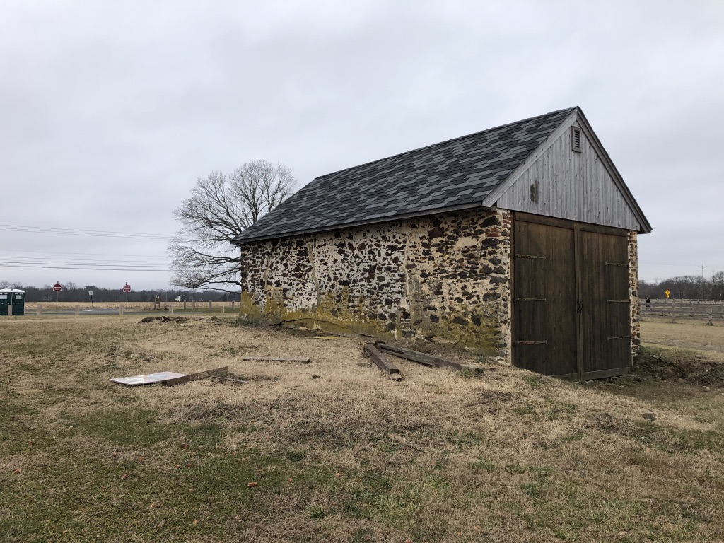
Proposal to Convert Swede Run Fields to Pollinator and Native Grass Fields
A unique opportunity to convert unused farm fields into a diverse and healthy habitat
4/12/2021

Slide 2
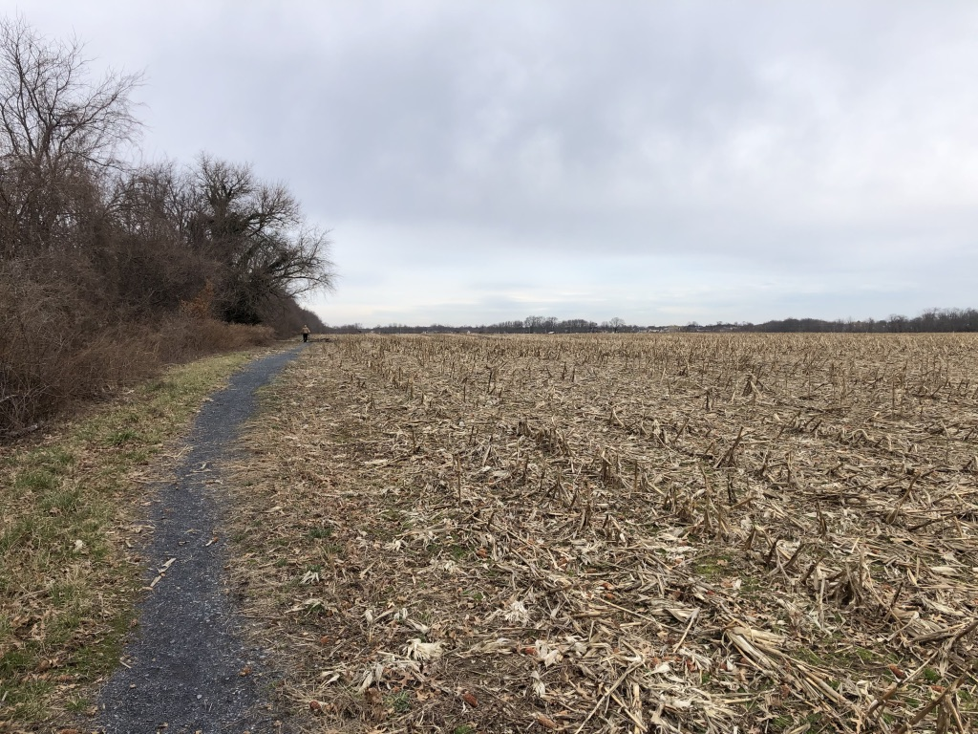
Current Status of Property
Swede Run Field
  Total parcel is approximately 130 acres
    40 acres on eastern side of Westfield Road, includes a dog park, parking, and a historic building
    90 acres on western side of Westfield Road is undeveloped, (approximately 70 of the 90 acres is tillable)
    Swede Run Creek borders portions of property
    Trails in poor shape run perimeter of both parcels
  Farming History
    Property was farmed for generations
    Last crop was soybeans
    Property last farmed in 2018
  Open Space
    Property acquired as Open Space in 2001
  Property is currently fallow, primarily supports both invasive and native plants – Township is mowing property annually

Slide 3
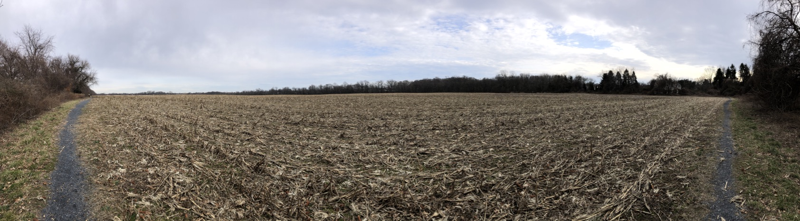
Opportunity to convert fallow land into a natural landscape providing benefits to pollinators, birds, and Moorestown residents
Potential options for the land
Convert to 100% pollinator fields (limited benefits)
Convert to mix of pollinator and hay fields (difficult economics)
Convert to mix of pollinator and native grass fields (best choice)
Multiple Options for Use of Fields

Slide 4
Preferred Option – Convert to mix of Pollinator/Native Grassland Fields
  PROS
    High value habitat for pollinators
    Attractive landscape providing broad array of flowers and grasses over multiple seasons
    Property is large enough to offer habitat for state threatened grassland breeding bird species including Meadowlark, Bobolink and Grasshopper Sparrow – (50 yards from trees)
    No pesticide use
    Minimal herbicide use compared to farming
    Reduced soil erosion
    Federal programs available to offset some cost
  CONS
    Labor intensive and costly to establish
    Annual mowing required – township or contractor

Slide 5
US Fish and Wildlife Partners Program
    Program provides native pollinator/native grass seed and or specialized Truax seed drill for planting (not hay seed)
    US Fish and Wildlife can assist in planning
    US Fish and Wildlife assists in development of plan for controlling invasive plants at no cost
    Township can participate directly
    Contact: Elizabeth Freiday
            Private Lands Coordinator
            US Fish and Wildlife
            Elizabeth_ Freiday@fws.gov
    609.382.5263

Slide 6
US Fish and Wildlife Partners Project
  1.3 What is the Partners for Fish and Wildlife Program? The Partners for Fish and Wildlife Program is our primary mechanism for delivering voluntary on-the-ground habitat improvement projects on private lands for the benefit of Federal trust species. We provide technical and financial assistance to landowners to help meet the habitat needs of Federal trust species on private lands. Program projects may include improving habitat for any or all of the following: migratory bird species: anadromous fish species of special concern to the Service; endangered, threatened, or candidate species; species proposed for listing; and other declining or imperiled species.

Slide 7
Process to move forward
  US Fish and Wildlife (F&W) reviews the property to determine its fit within the Partners Program and determine the condition of the property
    Fish and Wildlife visited the site on 1/15/21 – “The project is located in the Delaware River corridor and will restore stop-over as well as breeding habitat for migratory birds. Restoration of vernal pools and pollinator habitat provide additional ecological, uplift while conversion of a large agricultural field to native grassland will benefit area-sensitive, grassland-dependent breeding birds that are of high conservation concern in New Jersey.” From the US F&W Draft Agreement dated 2/18/2021
  F&W develops a map of the proposed plan for property
  F&W creates a detailed plan for entire process, including preparation of the land for planting, planting, control of invasive plants, and long-term maintenance of the property.
  The Township has ability to provide direct input to the plan.
    Contact: Elizabeth Freiday
            Private Lands Coordinator
            US Fish and Wildlife
            Elizabeth_ Freiday@fws.gov
    609.382.5263

Slide 8
Township Responsibility
Mowing of property prior to planting and up to 3 times in first year if pre-emergent herbicide is used (3 tractor runs). Additional mowing required if pre-emergent is not used
Hiring of a commercial herbicide applicator- government provides herbicide and 32- foot boom sprayer – Glyphosate and pre-emergent over the entire field (2 tractor runs). Beth Freiday from US F&W holds state herbicide license. Per Don Hinchman, farmer, cost estimated at $15-$20/acre
  Glyphosate: 1000 gallons of 3% mixture for 100 acres. Or 0.3 gallons (38.4 ounces) of herbicide per acre.
  Plateau (Imazapic): 1000 gallons of 0.3% mixture for 100 acres. Or 0.03 gallons (4 ounces) of herbicide per acre.
  For “Row” crop farming as previously – Annual herbicide herbicide application at a higher concentration than proposed. After first year, only minimal spot treatment anticipated
Paying for experienced farmer to plant pollinator/native grass seed. Don Hinchman a farmer from Salem County interested in planting. He has done multiple field conversions for NJ Audubon and US Fish and Wildlife. Cost of $100/acre was quoted.
Have reached out to Nutrien Systems a NYSE listed company that provides field service including herbicide application for a firm estimate in providing services
Once fields are established, 2-3 years, Don Hinchman will harvest harvest and bale grass fields and sell to mushroom farmer. This will be done at NO COST to township. This also contributes to health of the grassland. Mowing limited to to the 30 foot (approximately one acre pollinator strip along Westfield Road after 2-3 years.

Slide 9
Township Estimated Costs
Township currently pays $4,400 to mow approximately 110 acres -$40/acre -annually
Western side of Swedes Run is approximately 70 acres
Assume 3 additional mowing’s (four total) of the 70 acres at $40/acre per county agriculture agent (agent thought no more than 3 in total year one)
  70*3*$40/acre = $8,400 for additional mowing
Assume 2 applications of herbicide using government 32-foot spaying boom
  Assume ½ to 1/3 the cost since sprayer is 32 feet vs 10-foot mower
  Herbicide applied by commercial applicator
  70*2*$20/acre = $2,800 for herbicide application
Experienced Farmer has quoted $100/acre to plant. (2.5X cost of mowing as seed drill is 5 feet vs. 10 for mower and higher level of expertise required)
  70*1*$100/acre = $7,000
Estimated cost of 2 acres of pollinators is $900 (8lbs per acre @$50/pound +Oats at $15/acre)
Oats as a “Nursery Crop” if needed for soil improvement ($15/acre *70 acres) =$1,050
May be additional costs for soil enhancements based on results of soil testing (recommended by agriculture agent)
  TOTAL COST OF IMPLEMENTATION = $20,150 W/O soil enhancements

Slide 10
Summary
  Swede Run Fields is the largest, un-forested, preserved open space in town
  In its current state, the property offers little in terms of passive recreation or habitat for pollinators and birds
  Conversion of the property to a mix of pollinator fields and native grasses offers many benefits:
    Improved habitat for pollinators and threatened grassland bird species
    Reduced soil erosion and silting of Swede’s Run
    Improved value of the site for passive recreation, including walking, nature viewing and bird watching
    Provides an opportunity to educate students and residents on the value of grasslands and pollinator fields
  The US Fish and Wildlife’s Partners program provides many of the resources required to convert the disused fields at Swede’s Run into a productive and healthy natural habitat. These resources include planning, herbicides, grass/pollinator seeds, and the necessary equipment for the preparation and planting of the fields.
  Townships primary responsibility is supplying “tractor time”
  Once grassland established, mowing not required as farmer will harvest crop resulting in a net cost savings to Township!
Unique Opportunity to Convert Former Farm Fields into Valuable Pollinator and Wildlife Habitat

Slide 11
Background

Slide 12
Option 1 – Convert to mix of Pollinator/Hay Fields
  PROS
    High value habitat for pollinators
    Property is large enough to offer habitat for threatened grassland breeding bird species including Meadowlark, Bobolink and Grasshopper Sparrow – (50 yards from trees)
    Attractive landscape providing broad array of flowers and grasses over multiple seasons
    No pesticides
    Reduced soil erosion
    Attractive throughout the year
  CONS
    Multi year process for plants to become well established
    Economics of establishing a hay field are extremely challenging
    US F&W Partners Program cannot be used for hay fields
    Annual mowing required of pollinator fields for township/ contractor

Slide 13
Option 2– Convert to 100% Pollinator Fields
  PROS
    High value habitat for pollinators and some birds
    Attractive landscape providing a broad array of flowers over an extended period of time
    No pesticide use
    Reduced soil erosion
    Federal programs available to offset some cost
  CONS
    Labor intensive and costly establish-$500 for seed alone per acre-$35,000 for seed alone!
    Annual mowing required – township or contractor
    No habitat for threatened grassland breeding bird species including Meadowlark, Bobolink and Grasshopper Sparrow

Slide 14
USDA – EQIP Program
  USDA National Resource Conservation Services EQIP Program (Environmental Quality Incentives Program)
    Provides up to 75% of cost (through reimbursement) for purchase of seeds (pollinator and native grasses – not hay seed)
    USDA provides review of property and a management plan at no cost
    A non profit or farmer must “control” the property
    Township not able to participate directly – must cede control of property to a non profit or farmer
    Contact
    Nicole Ciccaglione
    District Conservationist – FDA NRCS
    Nicole.ciccaglione@usda.gov
    609.534.9477

Slide 15
Notes on Hay Farming
  Talked with Bill Bamka Rutgers/Burlington County Agriculture & Kenny Carlisle (farms Winner Farm property)
    Minimal difference in attractiveness to birds vs. native grasses
    Hay is a low pesticide crop
    Hay in our area is typically cut 2 to 3 times a season
    Best crop is typically late May to middle June
      Farming for wildlife species requires delay of cutting until mid-July
        Reduces both quality of hay as food source and its economic value
    Yield is approximately 40 bales/acre total – all cuttings
    Price for hay is approximately $5-$7/bale for first cutting
    Lowest quality hay (mulch hay) sells for $1-$2/bale
    Current farm lease for land (no water) is $50 to $70 per acre
    Farmer estimates startup cost at $400 - $500/acre
    Assuming 80 acres farmed; first year cost of $40K vs. $16K in revenue
Economics of starting hay fields appear daunting

